Slide 1






McStas advanced language features
- and other important, not so well known details
Peter Willendrup^{1,5}
Emmanuel Farhi²
Erik Knudsen^{1,5}
Uwe Filges³
Kim Lefmann^{4,5}
¹DTU Physics, Lyngby, Denmark
²Calcul Scientifique, Institut Laue-Langevin (ILL), Grenoble, France
³Niels Bohr Institute, University of Copenhagen, Copenhagen, Denmark
4Paul Scherrer Institut, Villigen, Switzerland
5ESS DMSC, Copenhagen, Denmark

Slide 2
What is really the information content…?
McStas sources generally provide “intensity” in units of neutrons/s (into a chosen solid angle)
That intensity is carried through the instrument on a discrete set of “neutron rays”

Slide 3
Onto efficiency…
Apply focusing techniques
At the source (spatially, temporally, in wavelength…)
At the sample, if possible
(carefully!) Apply SPLIT - but only if immediately followed by Monte Carlo choices, e.g. in sample
Alternatively use MCPL o/i which allows repetition - beware of biases!

Slide 4
Onto efficiency…
Apply focusing techniques
At the source (spatially, temporally, in wavelength…)
At the sample, if possible
(carefully!) Apply SPLIT - but only if immediately followed by Monte Carlo choices, e.g. in sample
Alternatively use MCPL o/i which allows repetition - beware of biases!
All of this can be considered “variance reduction”
or biasing

Slide 5
Onto efficiency…
Use MPI parallelisation - included in macOS install from 2.4, easy to get on Linux…
The Intel C compiler is known to give ~factor of 2 wrt. gcc in most cases
- Still consider if you are asking the right question if runtimes reach days/weeks…

Slide 6
Advanced language features
Macros and tricks for your instrument...

Slide 7

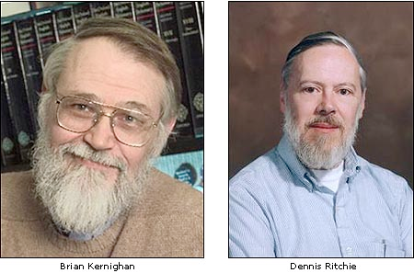
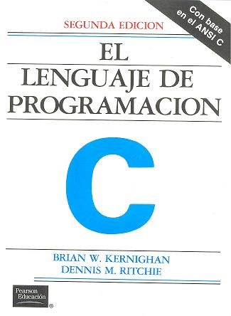
DECLARE / INITIALIZE
Use the DECLARE section define user variables and functions.
DECLARE %{
double myvar;
%}
Use INITIALIZE for initialization of user variables and calculations.
INITIALIZE %{
myvar = sqrt(PI*input_var)*rand01();
%}
- Both use normal c-syntax.
BEWARE: (example) What you do in the c-style areas is c-standard, e.g. trigonometric functions from math.h use radians! - McStas placement specifiers work in degrees, etc...
K & R

Slide 8
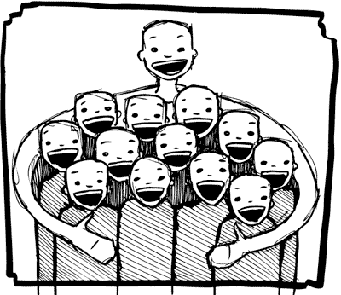
%include
Instrumentfiles can include external c-code or other instrumentfiles... See the examples:
ILL_H15_IN6.instr:%include "monitor_nd-lib"
ILL_H16_IN5.instr:%include "ILL_H16.instr"
ILL_H25_IN22.instr:%include "ILL_H25.instr"
ILL_H25_IN22.instr:%include "templateTAS.instr"
Used in the DECLARE section

Slide 9
Syntax in one, complex view...
{SPLIT} COMPONENT name = comp(parameters) {WHEN condition}
AT (...) [RELATIVE [reference|PREVIOUS] | ABSOLUTE]
{ROTATED {RELATIVE [reference|PREVIOUS] | ABSOLUTE} }
{GROUP group_name}
{EXTEND C_code}
{JUMP [reference|PREVIOUS|MYSELF|NEXT] [ITERATE number_of_times | WHEN condition] }

Slide 10
SPLIT
Increase statistics beyond this point in the instrumentfile
SPLIT n MyArm = Arm()
AT somewhere
will “formulate an if-statement”:
for j=1:n
comp1
comp2
comp3
...
end (of instrument)
ONLY meaningful in case of Monte Carlo choices after SPLIT point...

Slide 11
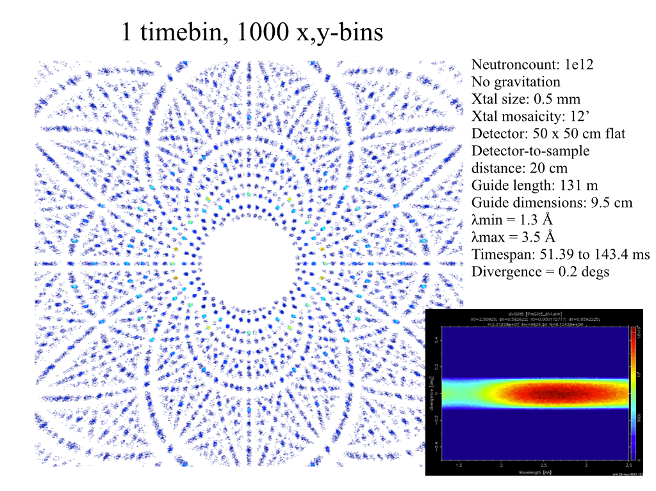
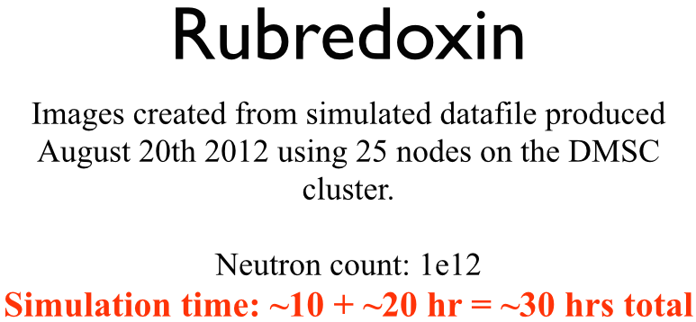
Problem: McStas Single_crystal.comp “slow” for large unit cell diffraction studies
slight sidetrack….
Example: Rubredoxin
Reflection list ~ 124 K reflections (still “small” in the PX world!!)

Slide 12
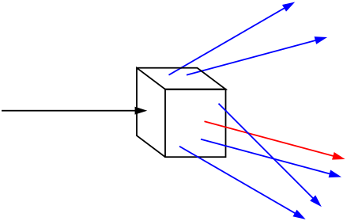
Algorithm improvement: Use incoming neutrons more efficiently - scatter each one on all possible reflections
slight sidetrack….
Red: Original algorithm, one incoming neutron used only once
Blue: Improved algorithm, each incoming neutron scattered (via SPLIT keyword) all possible times
Component makes estimate on average number of “active” diffraction spots - in the case Rubredoxin this is around 50!

Slide 13
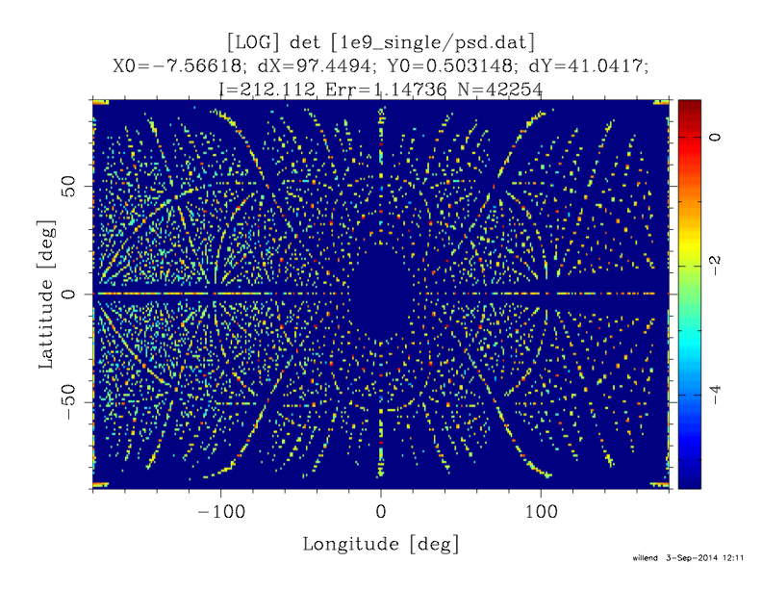
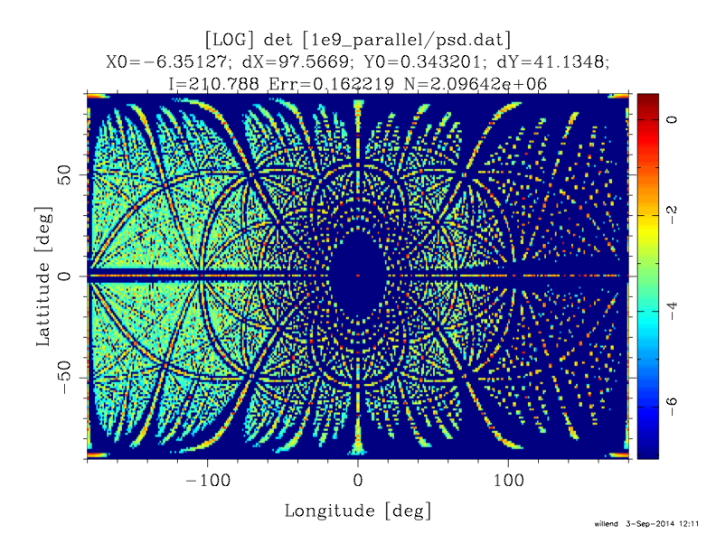
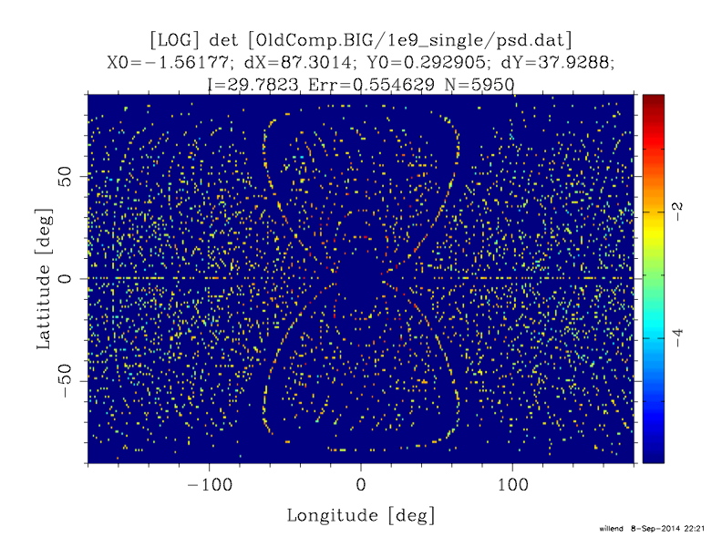
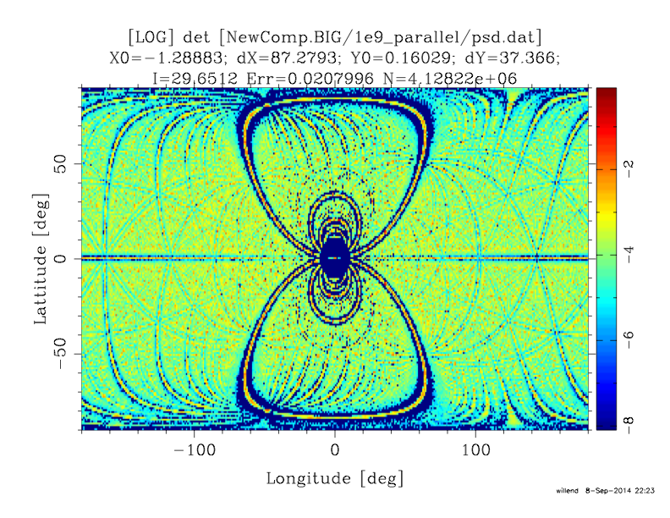
Sim data speak for themselves - 1e9 rays
slight sidetrack….
Old comp
New comp
~ Factor 50
more efficient
Rubedoxin
124K reflections
Predeuterated pyrophosphatase
1.7M reflections
~ Factor 500
more efficient

Slide 14

WHEN
Syntax:
COMPONENT Mine = Yours(blah, blah)
WHEN (c-expression) AT (....)
Is very powerful when combined with EXTEND and user variables, or as a method to let input parameters select if certain components are active.
Example: Use EXTEND to flag if neutron was scattered on one monochromator blade or another. Then later use WHEN to only show contribution from blade N at sample position?
COMPONENT Mon = PSD_monitor(...)
WHEN (myvar==1) AT (0,0,0) RELATIVE Sample
K & R

Slide 15

GROUP - components working in parallel
COMPONENT Mono1 = Monochromator_curved(...)
AT (0,0, -LMM) RELATIVE Cradle ROTATED (0,A1/2,0) RELATIVE Cradle
GROUP IN6Monoks
COMPONENT Mono2 = Monochromator_curved(...)
AT (0,0, 0) RELATIVE Cradle ROTATED (0,A2/2,0) RELATIVE Cradle
GROUP IN6Monoks
- One comp after the other is “tried” in sequential order until the neutron was SCATTERED.

Slide 16
EXTEND
Enrich component behaviour using EXTEND:
COMPONENT Mono1 = Monochromator_curved(...)
AT (0,0, -LMM) RELATIVE Cradle ROTATED (0,A1/2,0) RELATIVE Cradle
GROUP IN6Monoks
EXTEND
%{
if (SCATTERED) { myvar = 1; }
%}
...
COMPONENT Mono2 = Monochromator_curved(...)
AT (0,0, 0) RELATIVE Cradle ROTATED (0,A2/2,0) RELATIVE Cradle
GROUP IN6Monoks
%{
if (SCATTERED) { myvar = 2 ;}
%}
K & R

Slide 17
JUMP
A goto. Be careful. Can be used in two situations:
JUMP to myself
JUMP to an Arm
No coordinate transformations are applied... (Meaning that if the Arms you JUMP between do not coincide you will “move” / “reorient” the neutrons...)
Syntaxes:
COMPONENT a=b(...)
WHEN (expr) AT (...) JUMP somewhere
COMPONENT a=b(...)
WHEN (expr) AT (...) JUMP myself
Van Halen...

Slide 18
JUMP
A goto. Be careful. Can be used in two situations:
JUMP to myself
JUMP to an Arm
No coordinate transformations are applied... (Meaning that if the Arms you JUMP between do not coincide you will “move” / “reorient” the neutrons...)
Syntaxes:
COMPONENT a=b(...)
WHEN (expr) AT (...) JUMP somewhere
COMPONENT a=b(...)
WHEN (expr) AT (...) JUMP myself
BEWARE - This IS a GOTO!
Van Halen...

Slide 19
JUMP
A goto. Be careful. Can be used in two situations:
JUMP to myself
JUMP to an Arm
No coordinate transformations are applied... (Meaning that if the Arms you JUMP between do not coincide you will “move” / “reorient” the neutrons...)
Syntaxes:
COMPONENT a=b(...)
WHEN (expr) AT (...) JUMP somewhere
COMPONENT a=b(...)
WHEN (expr) AT (...) JUMP somewhere
BEWARE - This IS a GOTO!
Van Halen...

Slide 20
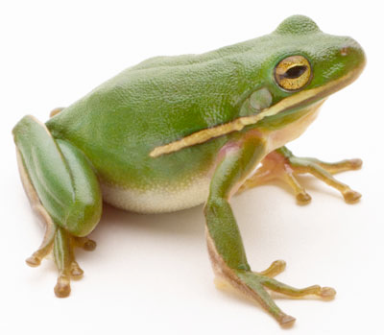
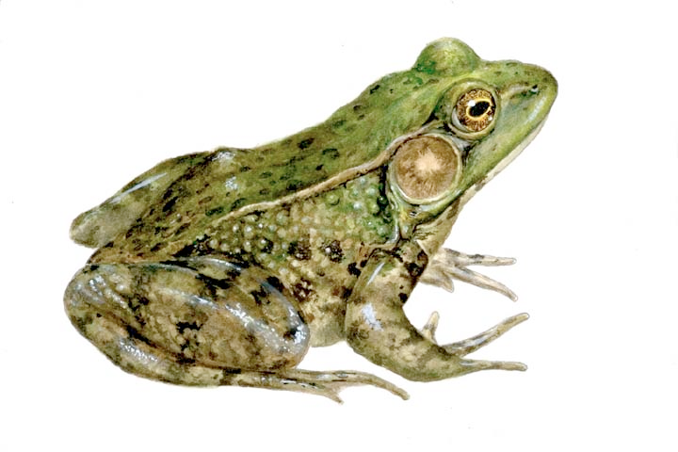
COPY- inside instruments
In instruments: (see ILL_H25.instr)
COMPONENT H25_1 = Guide_gravity(
w1=0.03, h1=0.2, w2=0.03, h2=0.2, l=L_H25_1,
R0=gR0, Qc=gQc, alpha=gAlpha, m=m, W=gW)
AT (0,0,Al_Thickness+gGap) RELATIVE PREVIOUS
ROTATED (0,Rh_H25_1,0) RELATIVE PREVIOUS
COMPONENT COPY(H25_1) = COPY(H25_1)
AT (0,0,L_H25_1+gGap) RELATIVE PREVIOUS
ROTATED (0,Rh_H25_1,0) RELATIVE PREVIOUS
COMPONENT COPY(H25_1) = COPY(H25_1)(W=2*gW)
AT (0,0,L_H25_1+gGap) RELATIVE PREVIOUS
ROTATED (0,Rh_H25_1,0) RELATIVE PREVIOUS

Slide 21
6 McStas various utils
Hidden gems and useful little things…
+ Disclaimers and tips for the next couple of days…

Slide 22
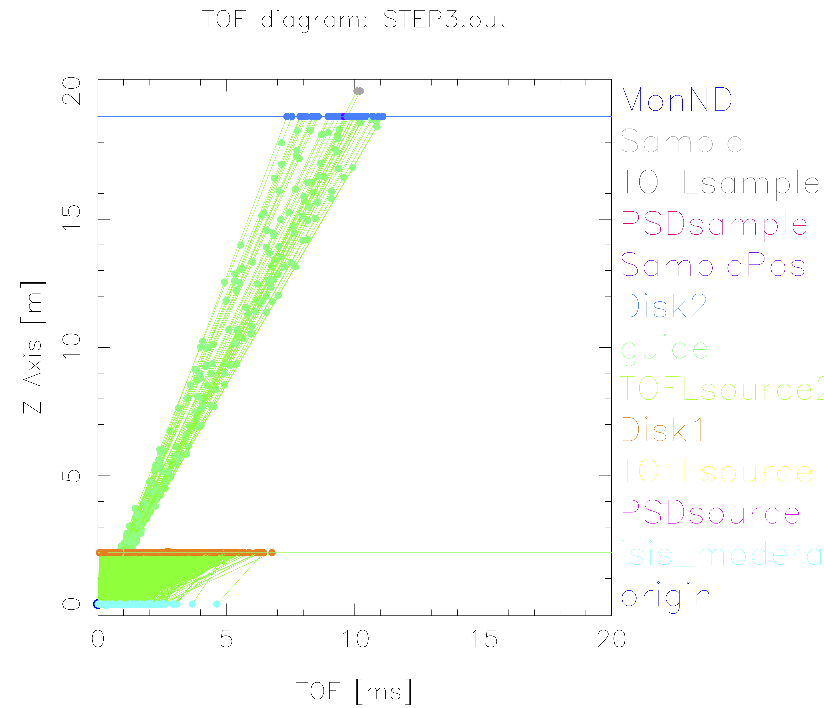
TOF diagram util based on mcdisplay
mcdisplay.pl --TOF --tmax=20 instrument…

Slide 23
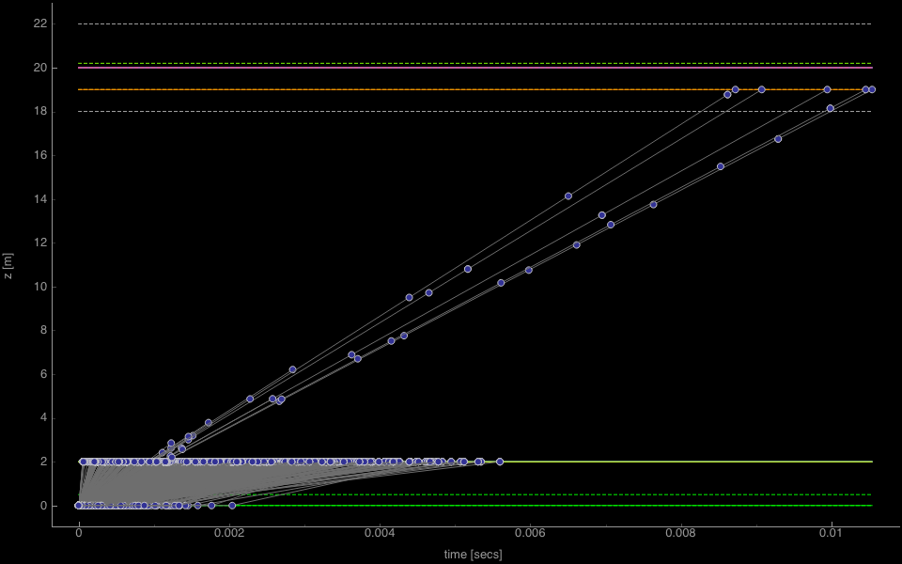
TOF diagram util based on mcdisplay
mcdisplay-pyqtgraph --TOF instr

Slide 24
Cluster utility scripts
./mcsub_slurm.pl
Usage: ./mcsub_slurm.pl [options] [mcrun params]
-h --help Show this help
-rN --runtime=N Specify maximum runtime (hours) [default 1]
-qQNAME --queue=QNAME Specify wanted SLURM queue [default 'express']
-e<mail> --email=<mail> Specify address to notify in reg. sim status [default none]
--nodes=NUM Specify wanted number of nodes [default 1]
--name=NAME Specify slurm job name [default "McSub_<USERNAME>_<TIMESTAMP>"]
After running ./mcsub_slurm.pl NAME.batch is ready for submission using the sbatch command
mcsub cluster scripts
Takes a “mcrun commandline”
Writes batch file “template” for use with PBS or slurm cluster queue systems
https://github.com/McStasMcXtrace/McCode/tree/master/tools/cluster-scripts

Slide 25
Vitess - compatibility
Utility script for converting Vitess reflectivity files for use with McStas (https://github.com/McStasMcXtrace/McCode/blob/master/tools/other/Refl_Vitess2McStas.sh)
mcstas2vitess generates Vitess module + tcl snippet from McStas component (poor docs, will improve)

Slide 26
Examples Directory
Simple grep →
370 examples of Monitor_nD
51 examples of Source_gen
10 examples of ISIS_moderator
10 examples of Single_crystal
Unix/Linux:
grep ISIS_moderator /usr/share/mcstas/2.4pre01/examples/*

Slide 27
Examples Directory
Simple grep →
370 examples of Monitor_nD
51 examples of Source_gen
10 examples of ISIS_moderator
10 examples of Single_crystal
They have an author name!
For instance:
ISIS_CRISP → R. Dalgliesh
SE_example → me (E. Knudsen)

Slide 28
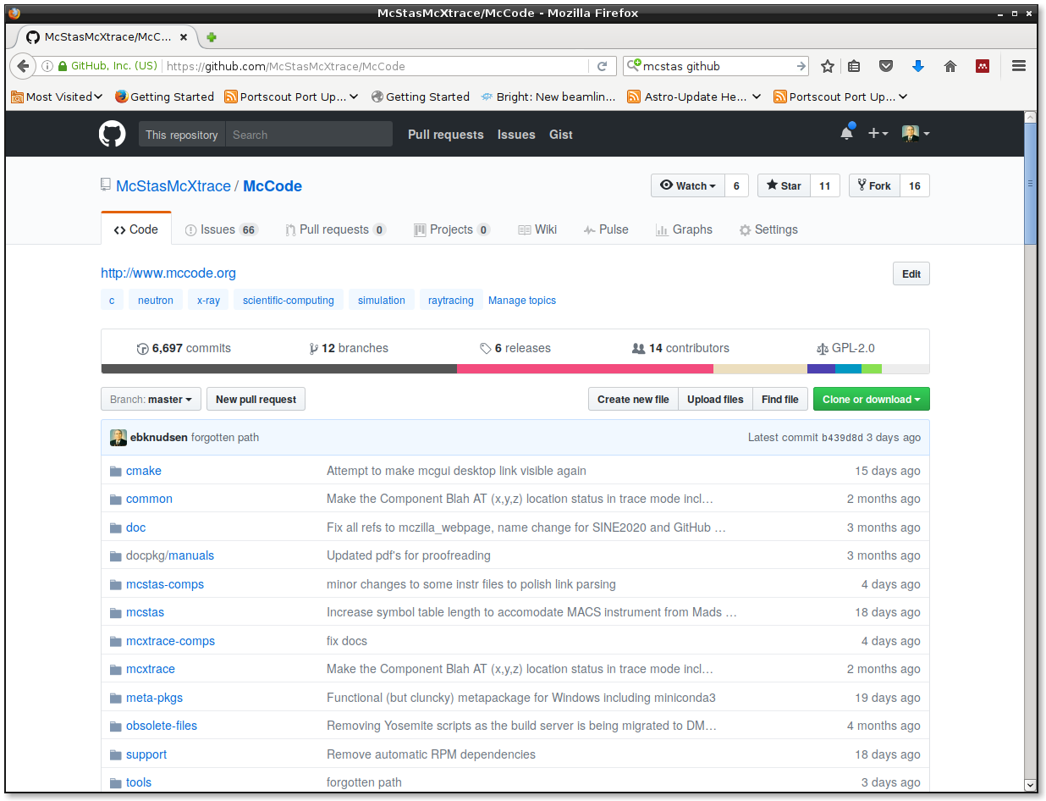
GitHub.com
https://github.com/McStasMcXtrace/McCode

Slide 29
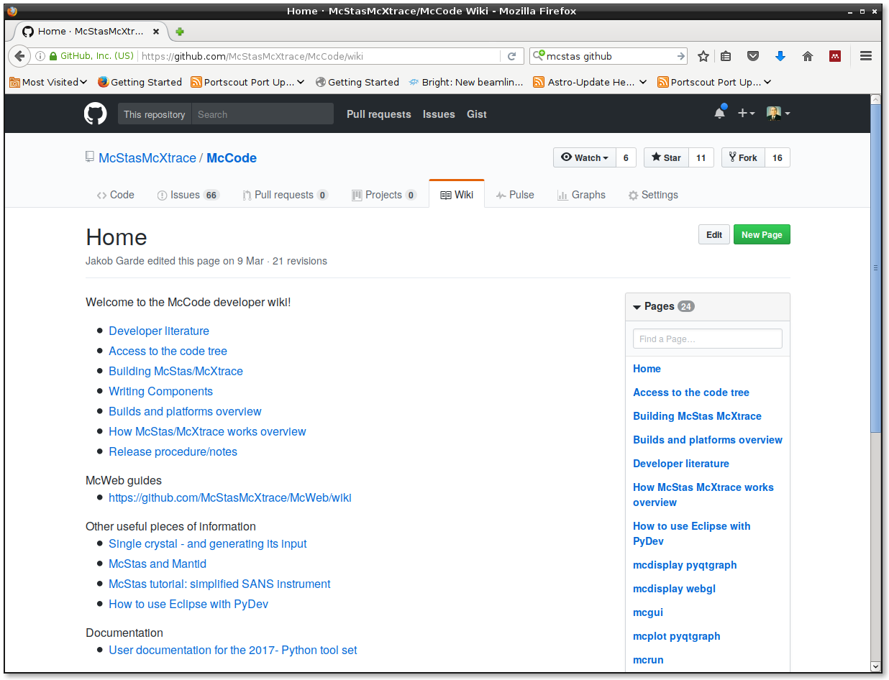
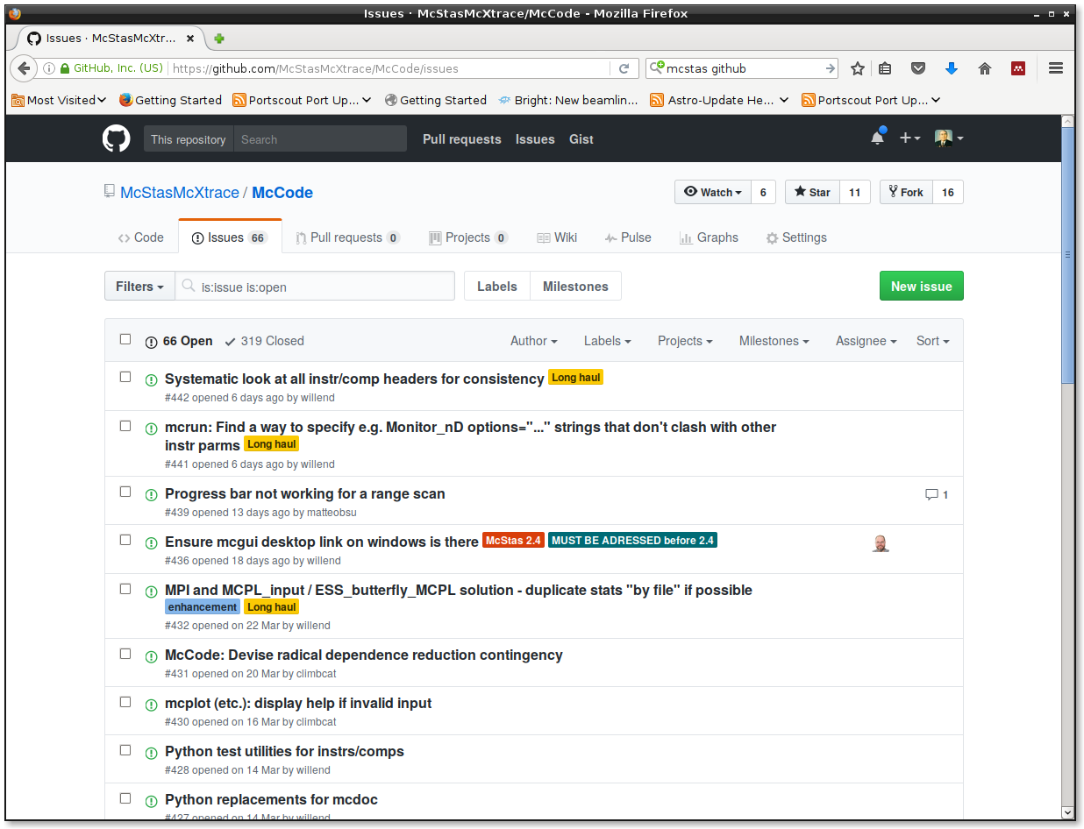
GitHub.com: wiki
Mostly developer oriented docs so far
https://github.com/McStasMcXtrace/McCode

Slide 30
GitHub.com: Issue Tracker
https://github.com/McStasMcXtrace/McCode

Slide 31
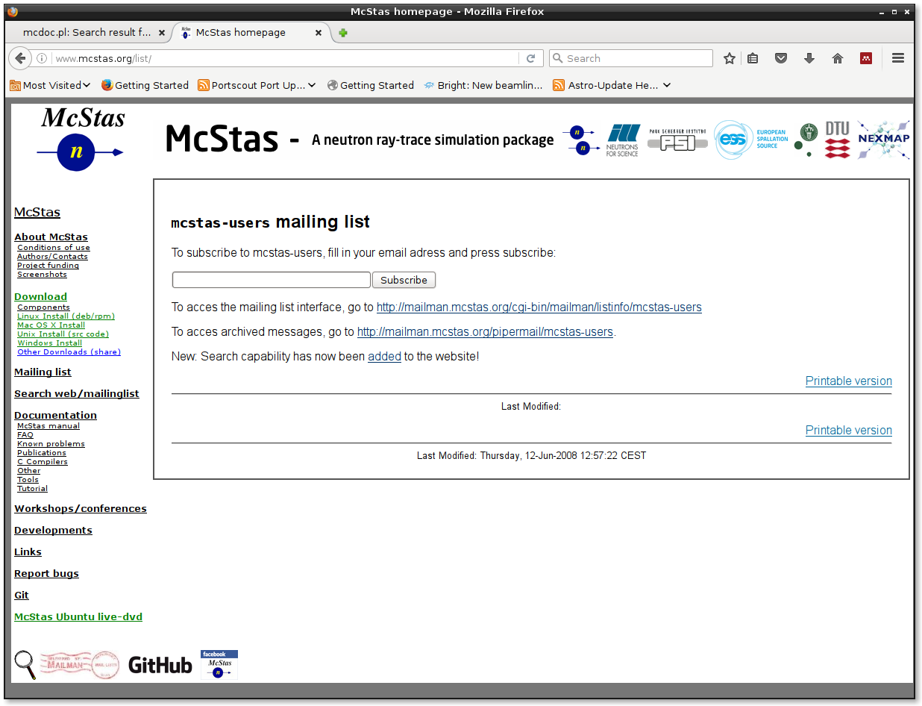
Mailing List

Slide 32
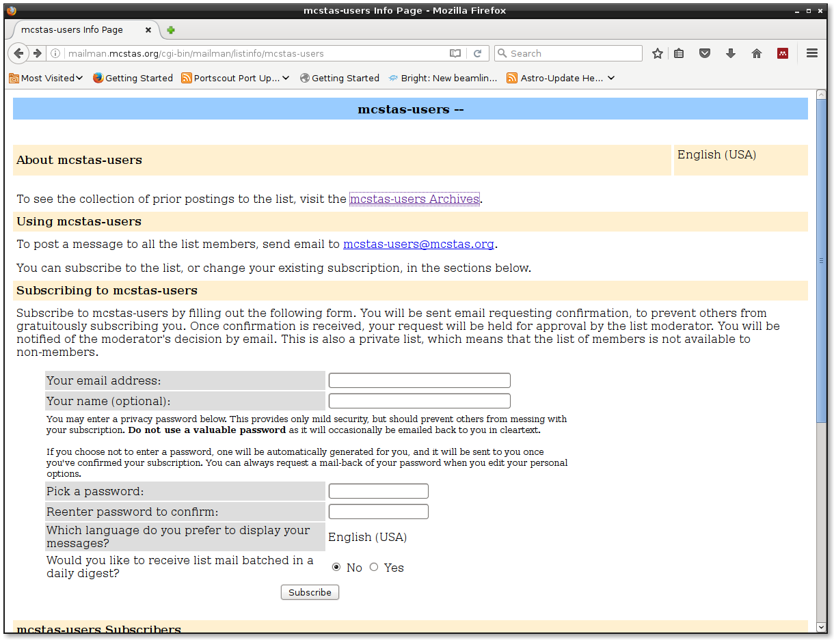
Mailing List

Slide 33
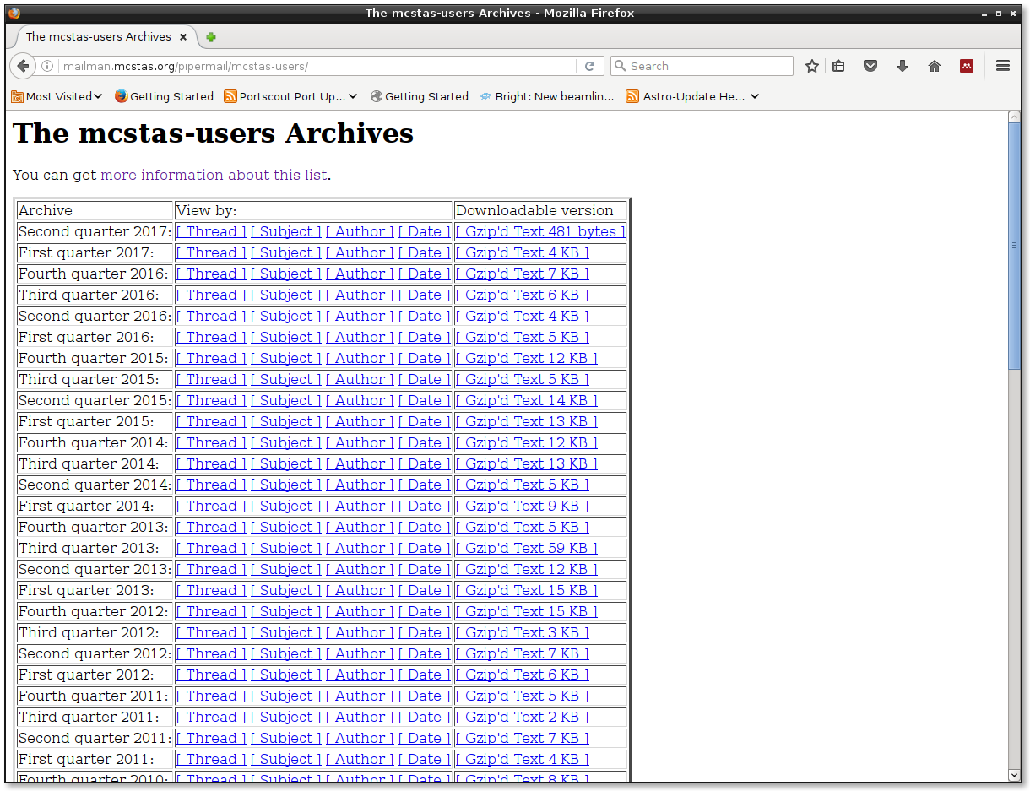
Mailing List - Archive

Slide 34
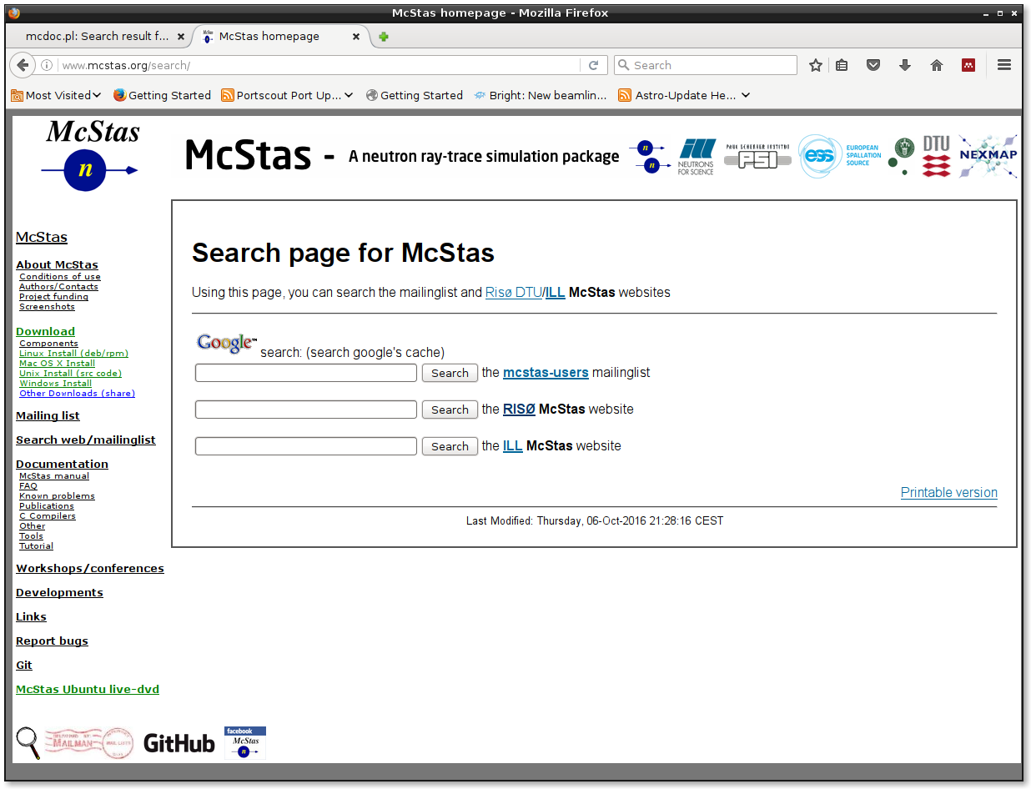
Mailing List Search page

Slide 35
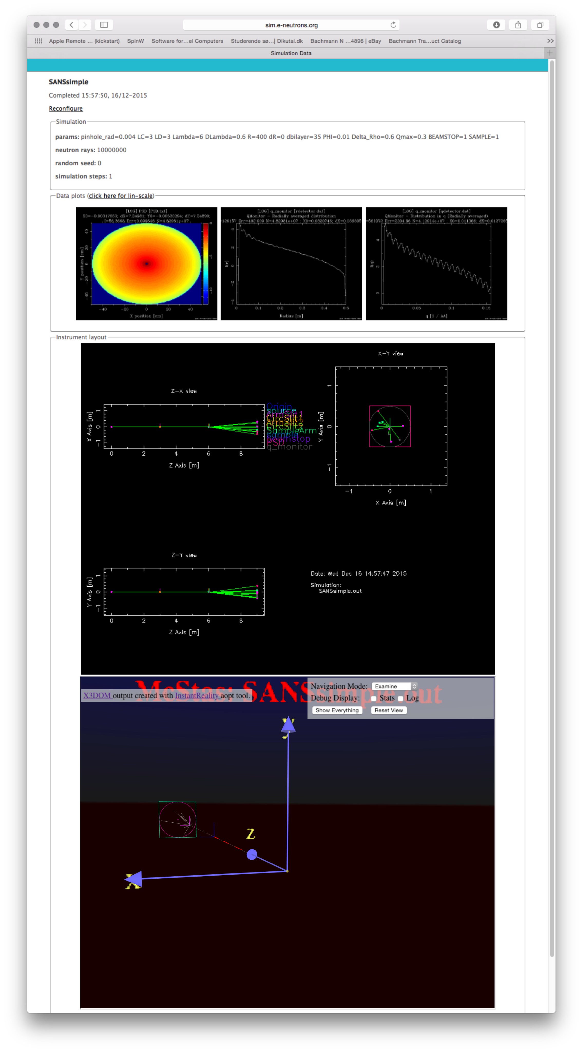
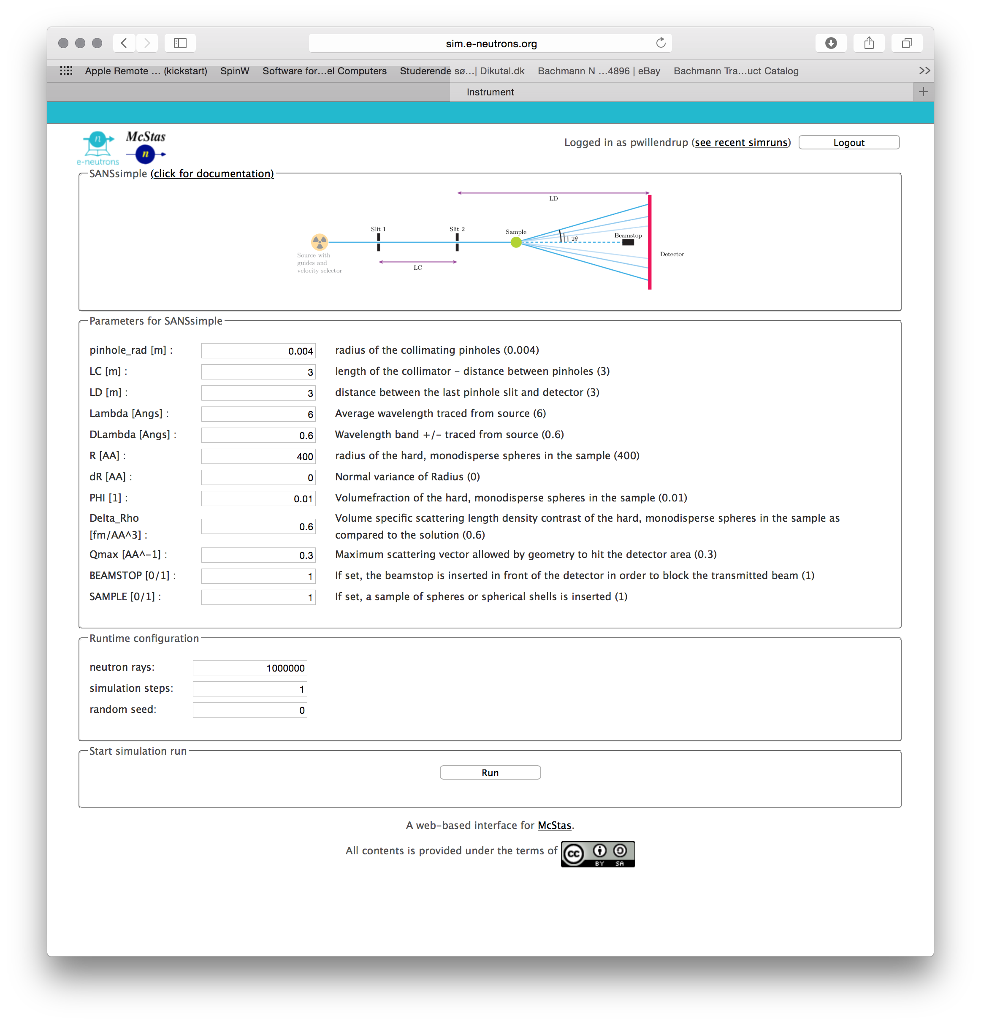
Web interface @ e-neutrons.org

Slide 36
Web interface @ e-neutrons.org
Only pre-defined instruments!!!

Slide 37

Web interface @ e-neutrons.org

Slide 38
Web interface @ e-neutrons.org
Online-course on neutron scattering available!

Slide 39
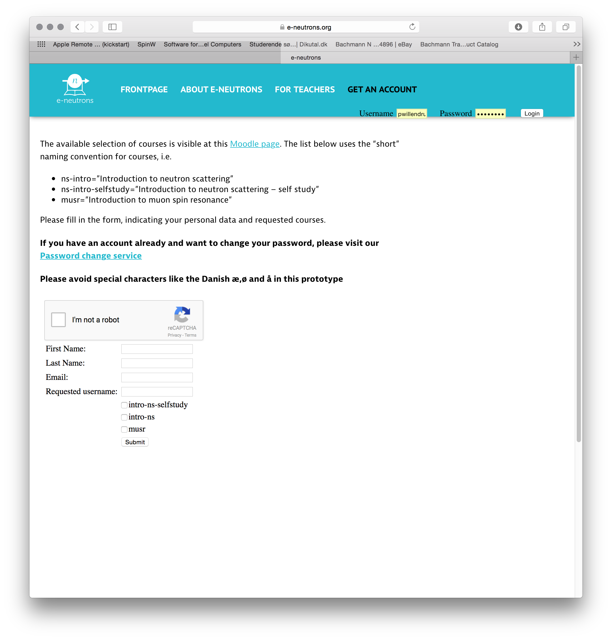
Web interface @ e-neutrons.org

Slide 40
Web interface @ e-neutrons.org
Free subscription!!

